Slide 1
Final Project
최신기술프로젝트

Slide 2
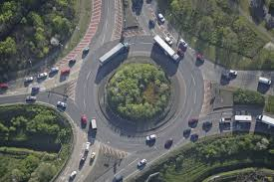
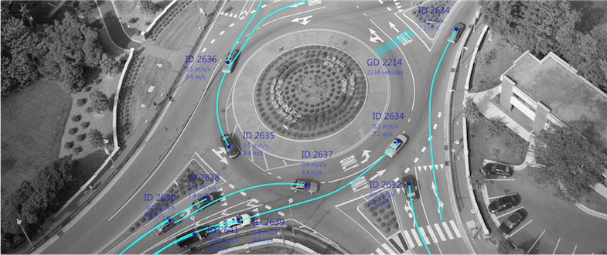
Want Information From Image !
Get Information!

Slide 3


How to Get Information in Image ?

Slide 4
How to Get Information in Image ?
It is hard to adopt distribution algorithm, because image composed of a matrix

Slide 5
How to Get Information in Image ?
Spark MLlib has image processing algorithm.
But spark performs navie image processing

Slide 6

Using Deep Learning
Image Segmentation!

Slide 7
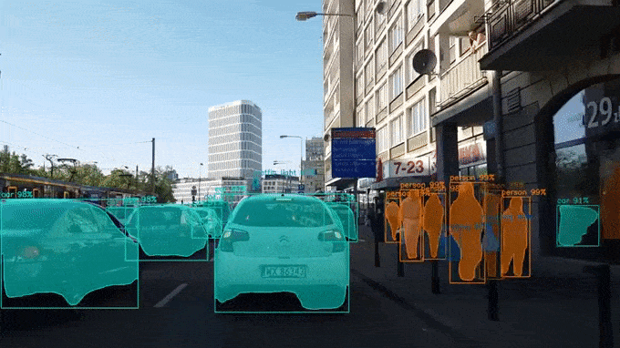
Mask -RCNN
Mask R-CNN is algorithm that performs image segmentation & detection
It is composed of Faster RCNN & R-FCN

Slide 8
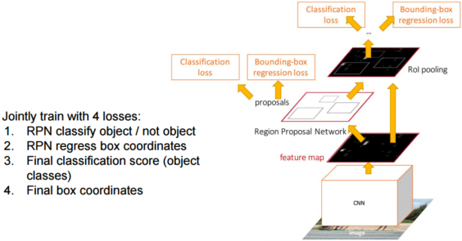
Faster R-CNN

Slide 9
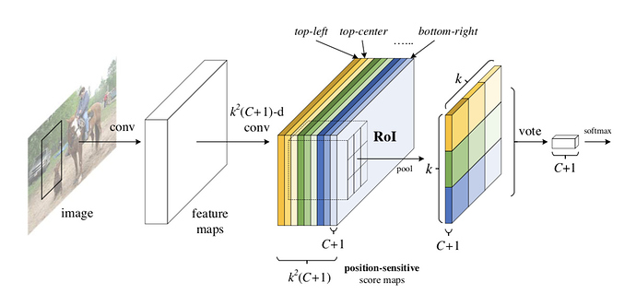
R-FCN

Slide 10
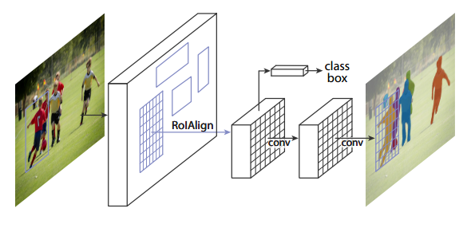
Mask R-CNN

Slide 11
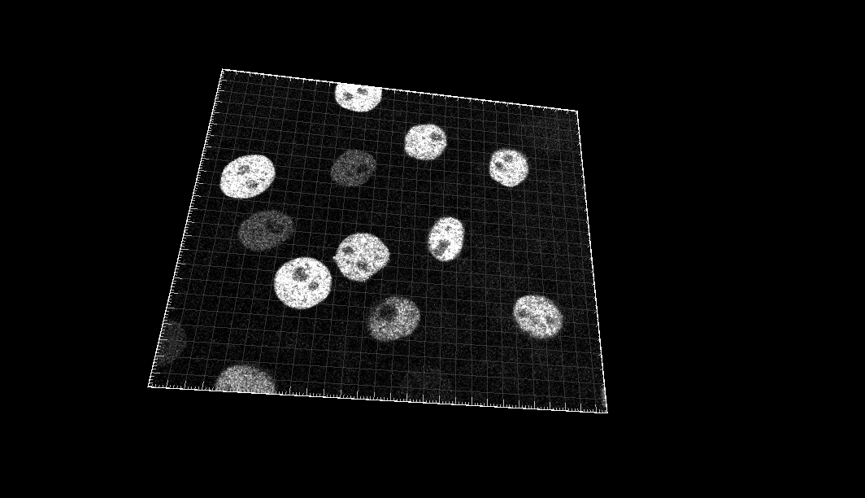
About Datasets
In Cell tracking Challenge
we get cell video sequences of fluorescent counterstained nuclei or cells moving on top or immersed in a substrate

Slide 12
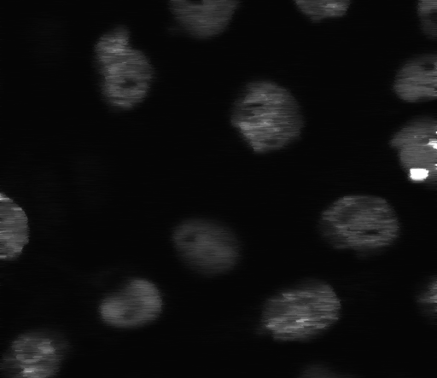
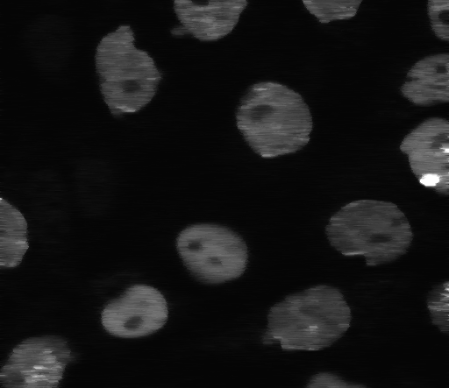
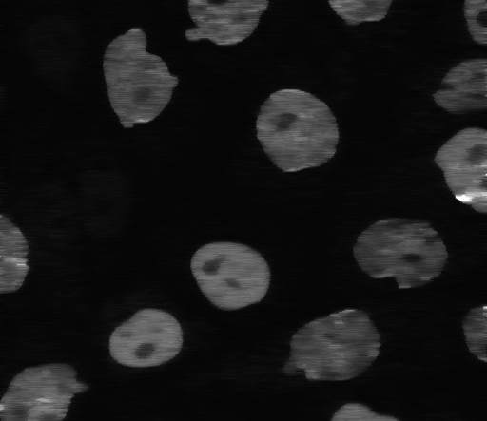
Data Preprocessing in local
Frame Split

Slide 13

Data Preprocessing in local
Split 103 Batch

Slide 14
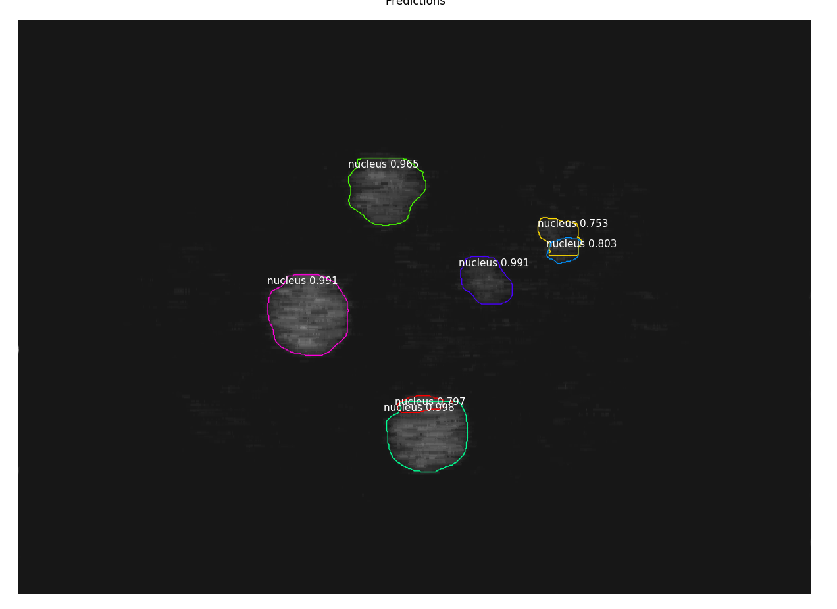
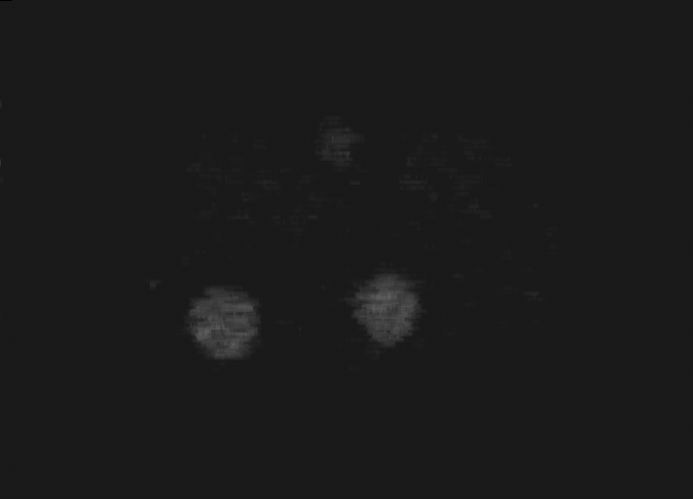
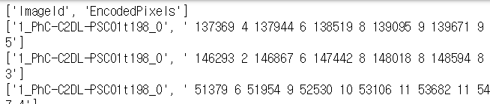
Data Acquisition from Image
Result Image
Mask R-CNN
Metadata

Slide 15
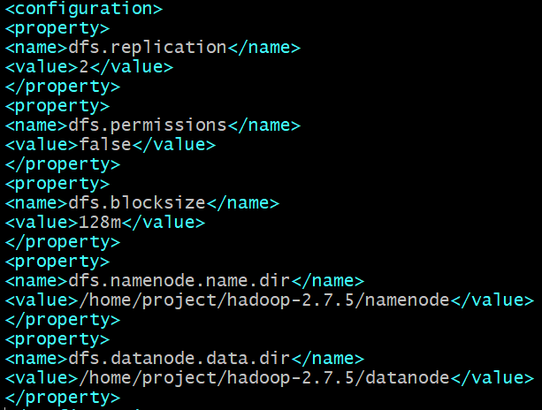
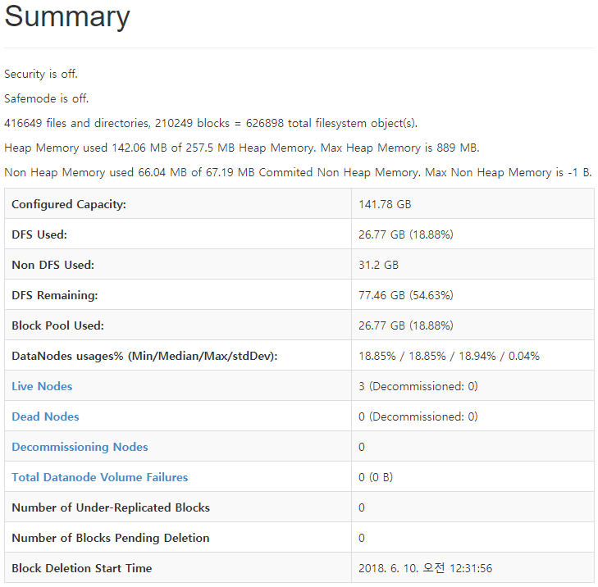
HDFS

Slide 16
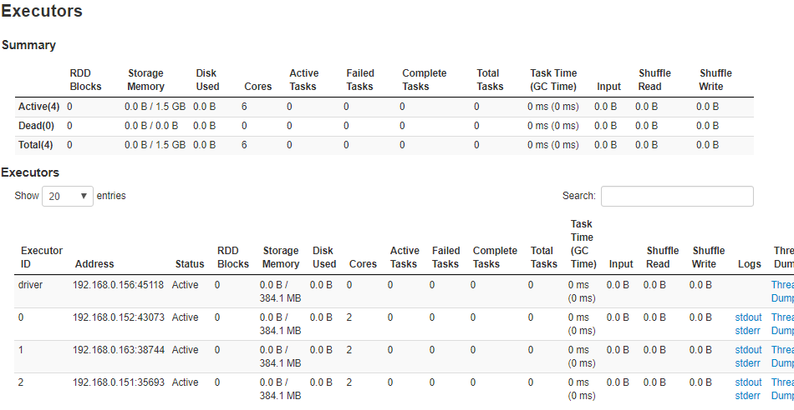
spark
1 master ,3 worker
standalone
cluster mode
<spark web ui>

Slide 17
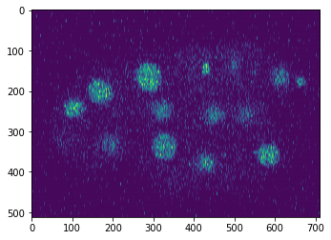
Spark Processing - Image preprocessing
Image has a noise!

Slide 18
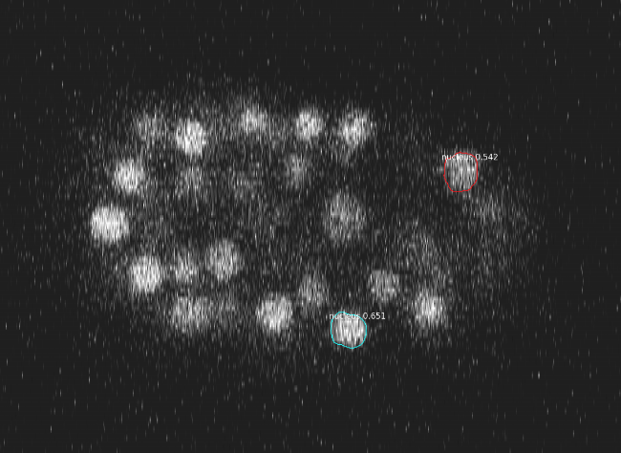
Spark Processing - Image preprocessing
Image has a noise!
So algorithm does not work well!

Slide 19
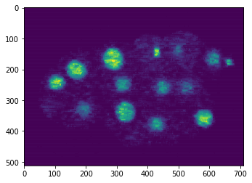
Spark Processing - Image preprocessing
Apply median filter in spark

Slide 20
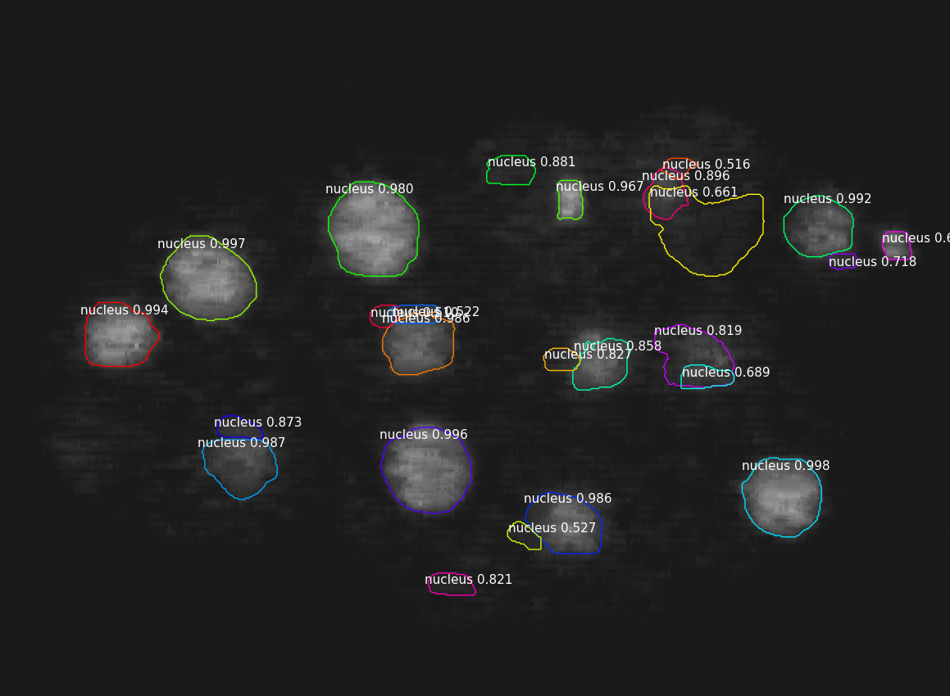
Spark Processing - Image preprocessing

Slide 21
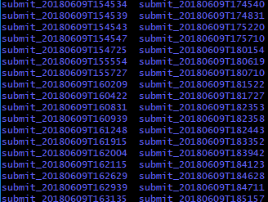
Spark Processing - csv processing
103 folders
png files & one csv in a folder

Slide 22
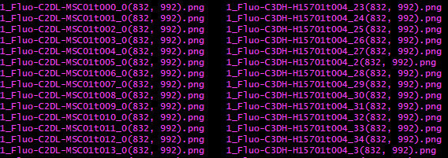
Spark Processing - csv processing
For decode,
need to know pixel size (shape)

Slide 23
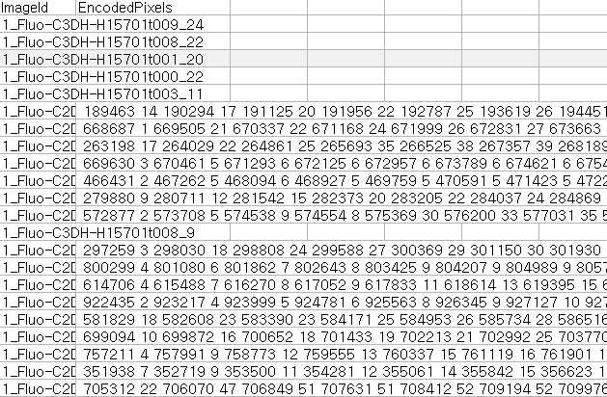
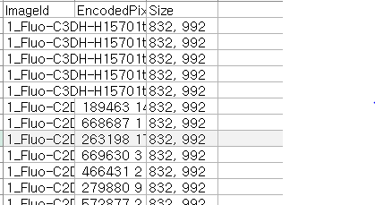
Spark Processing - csv processing
Before size process
After size process

Slide 24
Spark Processing - csv processing (Decoding)
ex) 189463 14 190294 17 ...
RLE Encoded Pixels
Mask Array
...
... 00000000 ...
... 00011110 ...
... 00011100 ...
… 00001000 ...
... 00000000 ...
...
Decoding
Function
ex) 832 x 992 = 825,344
Shape Value

Slide 25
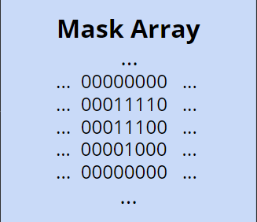
Spark Processing - csv processing (Decoding)
Count number of 1
cell ratio - 1’s count / shape

Slide 26
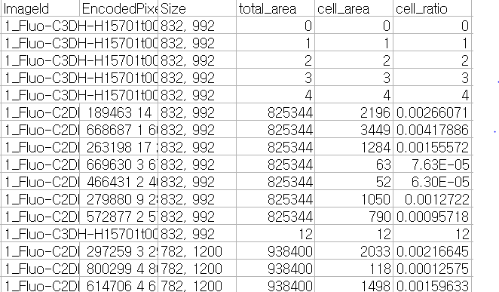
Spark Processing - csv processing
Before decoding
After decoding

Slide 27


Data Visualization

Slide 28
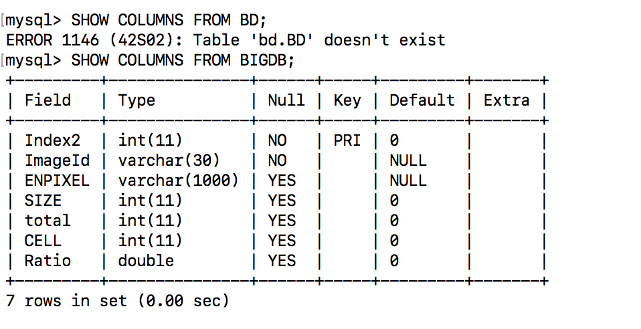
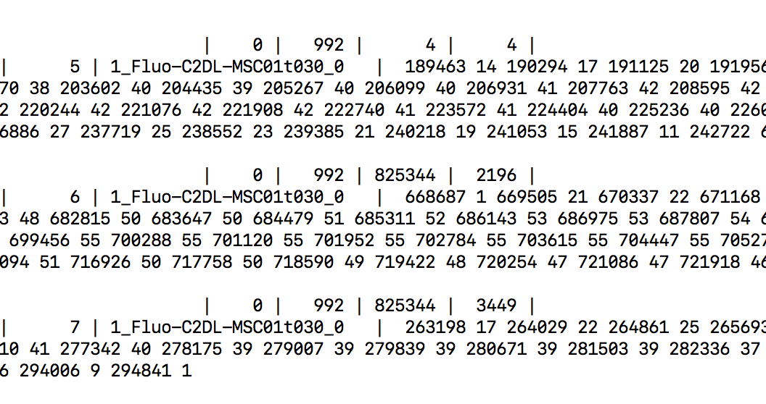
Data to Mysql

Slide 29
Thank you
http://133.186.134.34:8060

